Slide 1

Green Pace
Security Policy Presentation
Developer: Alex Walrond
CS 405
Prof. Mimi
08/22/2024

Slide 2

OVERVIEW: DEFENSE IN DEPTH
Defense in depth is a security strategy that involves thoughtfully layering multiple defenses to provide comprehensive protection against risks and vulnerabilities in a system

Slide 3
THREATS MATRIX
PROBABILITY | SEVERITY | Severity
 | LOW HARM | MEDIUM HARM | HIGH HARM
LIKELY |  |  | STD-003-CPP STD-005-CPP
PROBABLE | STD-007-CPP |  | STD-002-CPP STD-004-CPP STD-009-CPP STD-010-CPP
UNLIKELY | STD-006-CLG | STD-008-CPP | STD-001-CPP

Slide 4
10 PRINCIPLES
Validate
Validate Input Data
STD-001-CPP, STD-002-CPP, STD-004-CPP
Heed
Heed Compiler Warnings
STD-003-CPP, STD-010-CPP
Architect and Design
Architect and Design for Security Policies
STD-009-CPP
Keep
Keep It Simple
STD-008-CPP
Default
Default Deny
STD-005-CPP
Adhere to the Principle of Least Privilege
Sanitize Data Sent to Other Systems
Practice Defense in Depth Validate Input Data
Use Effective Quality Assurance Techniques
Adopt a Secure Coding Standard
STD-005-CPP
STD-004-CPP
STD-010-CPP
STD-001-CPP, STD-002-CPP, STD-004-CPP STD-001-CPP, STD-002-CPP, STD-004-CPP
STD-004-CPP
STD-010-CPP
STD-004-CPP
STD-006-CLG

Slide 5
CODING STANDARDS
Rule | Severity | Likelihood | Remediation Cost | Priority | Level
STD-005-CPP | High | Likely | Medium | High (18) | 1
STD-003-CPP | High | Likely | Medium | High (18) | 1
STD-004-CPP | High | Probable | Medium | High (12) | 1
STD-002-CPP | High | Probable | Medium | High (12) | 1
STD-009-CPP | High | Probable | High | Medium (6) | 2
STD-010-CPP | High | Probable | High | Medium (6) | 2
STD-007-CPP | Low | Probable | Medium | Low (4) | 3
STD-001-CPP | High | Unlikely | High | Low (3) | 3
STD-008-CPP | Medium | Unlikely | Medium | Low (4) | 3
STD-006-CLG | Low | Unlikely | High | Low (1) | 3

Slide 6
ENCRYPTION POLICIES
Encryption in rest - Protects stored data.
Hard drives, phones, computers, cloud assets, etc.
Encryption at flight - Protecting data that is moving.
Devices within a network or moving outside of a network.
Encryption in use - Protects data that is created, edited, or otherwise defined as in-use.
Ensuring protection is in place prior to use.
Source: https://www.mimecast.com/blog/data-in-transit-vs-motion-vs-rest/

Slide 7
TRIPLE-A POLICIES
Authentication: Verifies the identity of a user
Ensure a person is who they claim to be
Authorization: Determines what a user is allowed to do within a system
Defines The user's access rights and privileges
Accounting: Tracks and logs all user activities within the system
Creates A detailed log (breadcrumb trail) of user actions, including timestamps and accessed resources.
Source: https://www.ccsinet.com/blog/aaa-identity-management/

Slide 8
Unit Testing
Unit Testing: The process of verifying and validating individual components of a program or application to ensure they function and respond as intended.
Testing done with Google Test (gtest):
https://github.com/google/googletest/

Slide 9
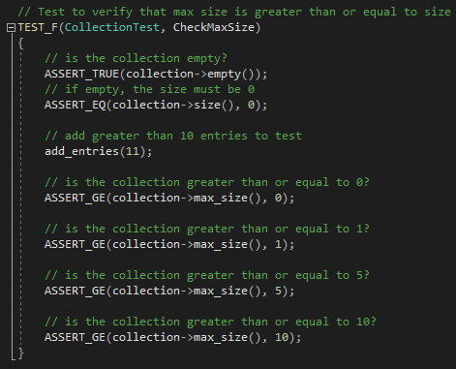
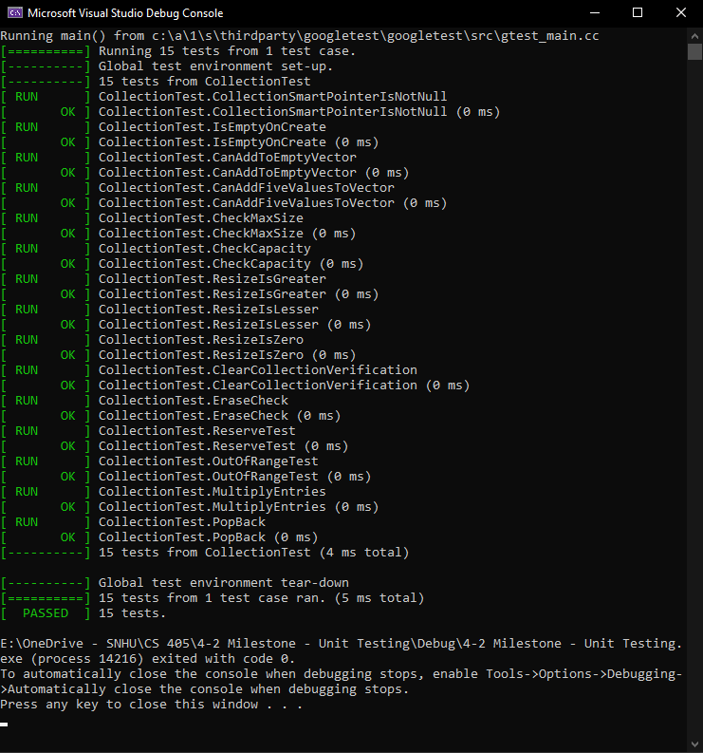
Check Max Size
This test is to verify max size is greater or equal to size for x number of entries.

Slide 10
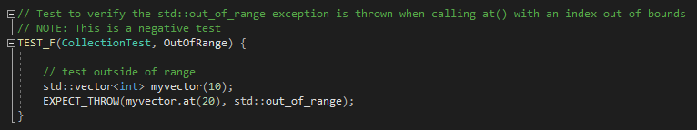
Out Of Range
This test is to verify an out-of-range exception is thrown when calling out of bounds.

Slide 11

AUTOMATION SUMMARY

Slide 12
TOOLS
DevSecOps means incorporating application and infrastructure security from the beginning of the development process.
Tools:
CPPCheck: A static code analysis tool that helps identify potential issues and improve code quality. Learn more
Clang: A front-end compiler for the LLVM project that provides a modern, modular compiler infrastructure. Learn more
Parasoft: An automated testing suite that offers comprehensive testing capabilities to ensure software quality and compliance. Learn more

Slide 13
RISKS AND BENEFITS
Risk of waiting:
Harm to data
Harm to customer trust
Financial cost
Potential future damages of multiple attacks
Benefits of early action:
Mitigate possible damage
Prevent threats
Create structure and consistency in security
Reduce possible testing overhead
Example case:
Adobe 2013 Data Breach
Date of case:
Result:
Over 150 million users impacted by the data breach, as well as a financial compensation as part of a settlement.
October 2013
Source: https://www.csoonline.com/article/2130877/the-biggest-data-breaches-of-the-21st-century.html/

Slide 14
RECOMMENDATIONS
Possible Gaps in Security Policy:
Ongoing Review and Update: While the policy provides a solid foundation, it should be regularly reviewed and updated to address emerging threats and gaps. Regular revisions ensure that the policy remains relevant and effective.
External Audits: Conducting annual security assessments by an external, reputable source—such as a white-hat security firm—can provide a real-world evaluation of the policy’s effectiveness and uncover potential vulnerabilities.
Early Integration: Implementing security policies early in the development and operational processes helps maintain a consistent focus on security and adapts to evolving challenges.

Slide 15
CONCLUSIONS
Adopting best practices and coding standards, implementing defense in depth, continually assessing the motives of potential attackers, and maintaining a “no one is safe” mindset towards security throughout development will help transform DevOps into DevSecOps at Green Pace.

Slide 16
REFERENCES
Argintaru, D. (2021). Data Encryption: How to Protect Data in Transit, Data in Use and Data at Rest. Mimecast. Read more
Authentication, Authorization, Accounting and Identity Management. (2018, April 3). CCSI. Read more
Fogg, E. (2021, May 11). What Can and Should be Automated in Software Development? ProdPerfect. Read more
Hill, M. (2021, July 16). The 15 Biggest Data Breaches of the 21st Century. CSO Online. Read more
What is DevSecOps? (2021). Red Hat. Read more

